Slide 1
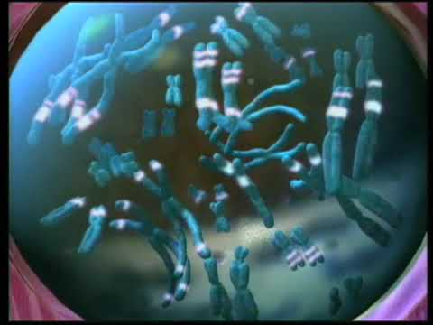
SEL Part #3

Slide 2
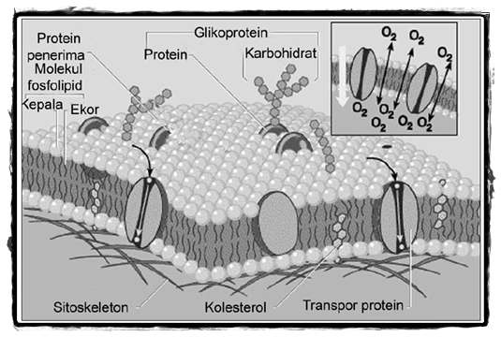
Struktur Membran Sel
Pertemuan 3

Slide 3
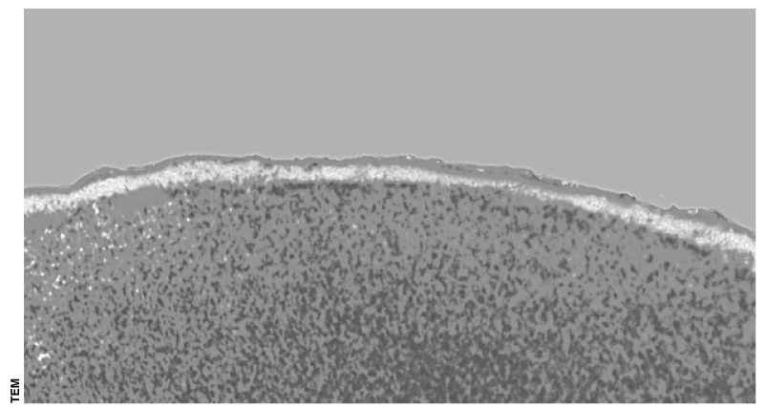
5.10 Membranes organize the chemical activities of cells
MEMBRANE STRUCTURE AND FUNCTION
Membranes organize the chemical reactions making up metabolism
→
→
Cytoplasm
Figure 5.10

Slide 4
Membranes are selectively permeable
They control the flow of substances into and out of a cell
Membranes can hold teams of enzymes that function in metabolism

Slide 5
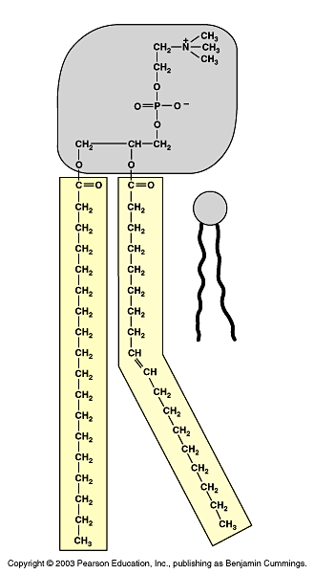
5.11 Membrane phospholipids form a bilayer
Phospholipids are the main structural components of membranes
They each have a hydrophilic head and two hydrophobic tails
Head
Symbol
Tails
Figure 5.11A

Slide 6
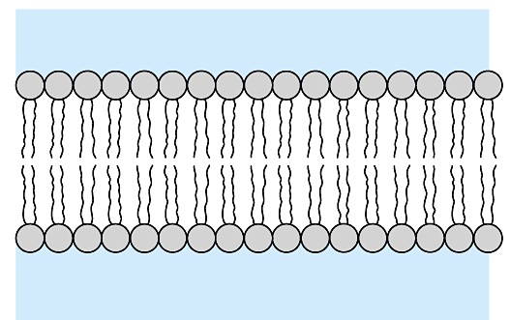
In water, phospholipids form a stable bilayer
The heads face outward and the tails face inward
Water
Hydrophilic heads
Hydrophobic tails
Water
Figure 5.11B

Slide 7
5.12 The membrane is a fluid mosaic of phospholipids and proteins
Phospholipid molecules form a flexible bilayer
Cholesterol and protein molecules are embedded in it
Carbohydrates act as cell identification tags

Slide 8
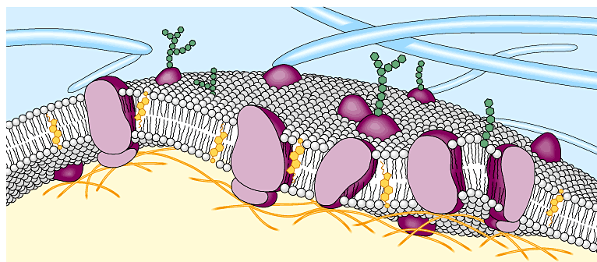
The plasma membrane of an animal cell
Glycoprotein
Carbohydrate (of glycoprotein)
Fibers of the extracellular matrix
Glycolipid
Phospholipid
Cholesterol
Microfilaments of the cytoskeleton
Proteins
CYTOPLASM
Figure 5.12

